Slide 1


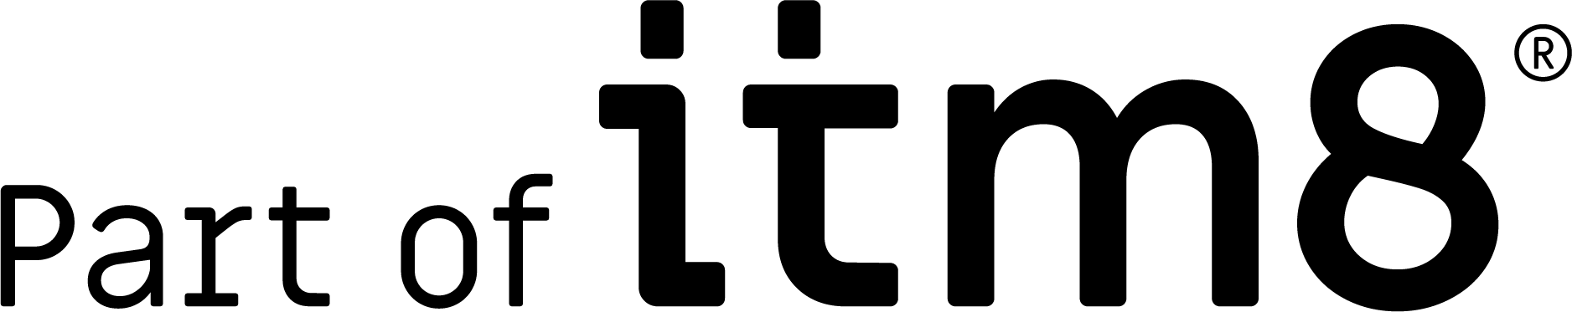
IT must support, not prevent innovation The world is not in a steady state. Companies has to respond effectively to changes, or face disruption (cliche but true)

Slide 2


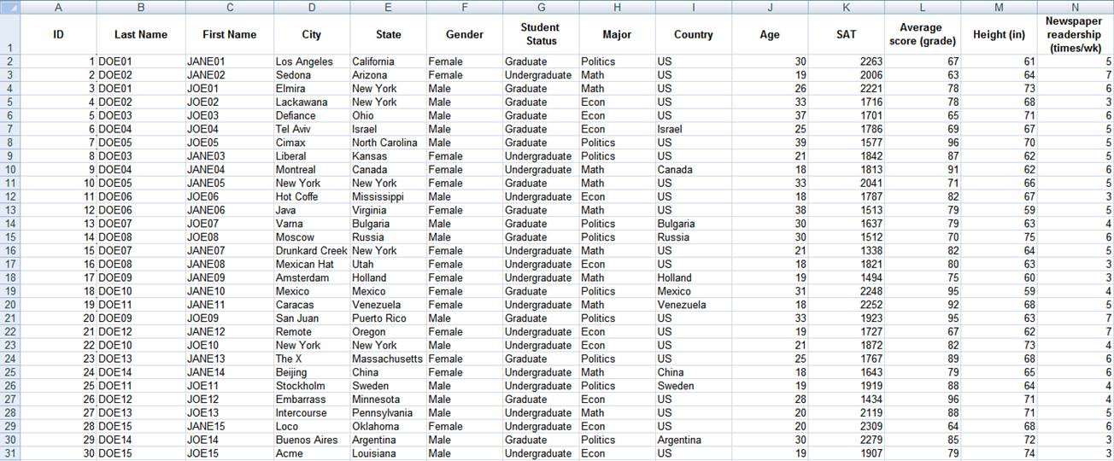


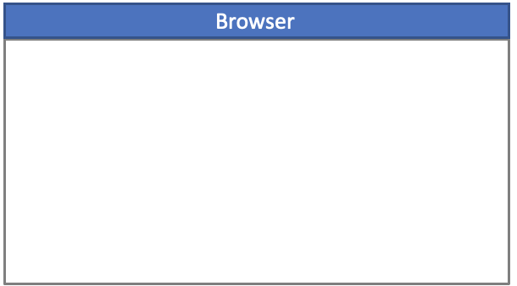
IT Architecture
100% Cloud
Integration
On Premise
Legacy
HR
CRM
ERP
Flat files
Extend apps
90% of business needs
Vendor Lock-in
FutureForms
The last 10% that makes the difference

Slide 3
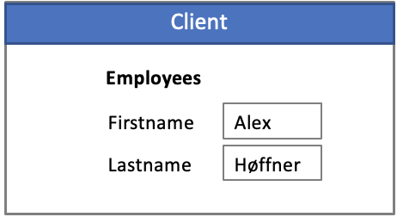
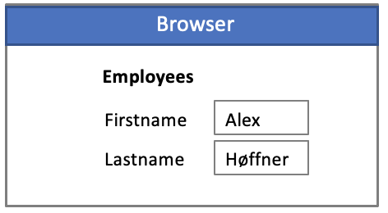
Development tools
1985
2000
2023
Focus:
Business applications
OracleForms
Informix 4GL
PowerBuilder
Microsoft Access
…
Focus:
Web-sites
Vue
React
Angular
Business Focus (low code)
Apex
Visual Builder
MS Power apps
Lack of tools for building business applications
Open source FutureForms delivers the efficiency of old 4GL/RAD tools, on bleeding edge technology

Slide 4
Database
1985
Dedicated
Connections
2023
Pooled
Client/Server
1000 concurrent users
(StateFul)
Leveraging all database features.
Transactions, row-locking, read consistency, cursors etc.
High performance
3 Tier Architecture
50000 concurrent users
(Stateless)
Poor utilization of database features.
Concurrency issues
Compensating transactions
Bad performance due to excessive commits and query re-executions
Rest

Slide 5
Applications
Dedicated
Connections
Pooled
Stateful
When needed
Stateless
Standard approach
Lots of Javascript
(not always easy)
NodeJS etc
Loads of services
FutureForms
Best Practice Components
Bind any html tag to database (no code)
Extendable. No limitations. Full code control
OpenRestDB (ORDS & PostgREST)
Exposes database as REST (no code)
Share connection with other services
Rest

Slide 6
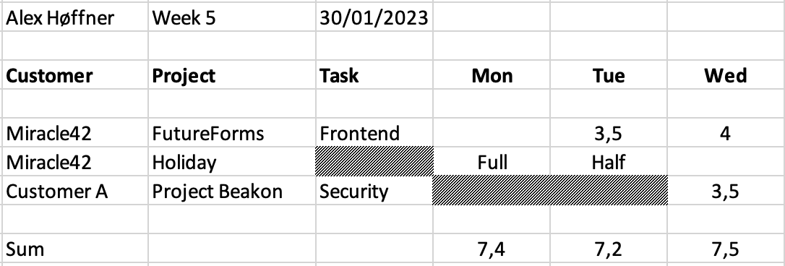
FutureForms
Application is not just about performing CRUD operations
Task is mandatory, except for holidays
Cannot choose same project/task twice
When holiday, limit time entry to Full/Half
Beakon is closed every monday and tuesday
If data has been processed it cannot be updated
Most columns are “lookups”, but should be queryable
Underlying table is “normalized” and has 1 row per date/task
Employee_id
Customer_id
Project_id
Task_id
Date
Hours
Processed
No code and Low code tools are not always adequate

Slide 7
FutureForms
Key features
Open Source
Components not Framework
Object oriented (80 objects)
Easy to extend
Easy to customize
Easy to create custom tags
Familiar event trigger model
Written in TypeScript
Total segregation of duties
Supports continuous integration
Scales to large development projects
Mouseless operation
No restrictions on html
Rest

Slide 8
FutureForms
HTML
Library
Logic
Most Notable Objects
Form:
Blocks, Eventhandling
Block:
Optional intersection between Datasource & Fields
Datasource: (Interface)
Get data from any source
ListOfValues: (Property palette)
List of valid values for given field
CustomTag:
Replace any tag with custom code
Menu:
Create static or datadriven menues
Inject
Use
Add
Rest

